Slide 1
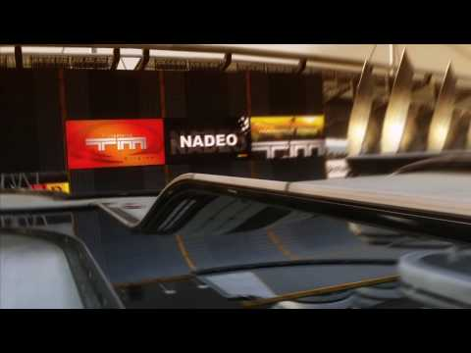
TMCHALLENGER
By:
Kamal Nimmagadda
Mehul Kohli
Ritika Singhal
Rohan Marathe

Slide 2
Project Description
Creating a racing agent for the game of TrackMania
Training the model to find the best path to complete the speedrun for any given map

Slide 3
Objective
To be able to perform a speedrun capable of going head to head with world top performers on A01-race.
To be able to perform a speedrun on multiplayer online maps.

Slide 4
DQN Model
States: A stack of 6 frames in real time from the gameplay, speed list and timestamp list in the 6 frames.
Input Shape (6 frames): 6 x 80 x 60
Actions: 7 possible actions
Replay Memory: For random sampling of initial states fed into the model
Reward… (next slide)

Slide 5
Model Rewards
Positive Reward for Speed: R(speed) = max(speed recorded for 6 frames)/(6th timestamp values in seconds)
Positive Reward for completing the race: 100
Negative Reward for getting stuck on the track = -500/(6th timestamp values in seconds)
Negative Reward for choosing brake or reverse action = -25
Cumulative Reward = Sum of all the above 4 rewards.

Slide 6
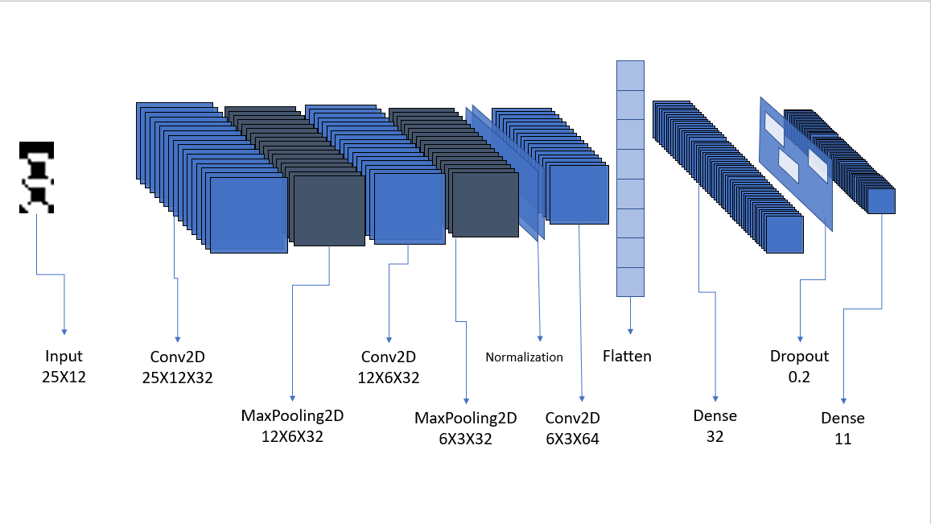

Slide 7
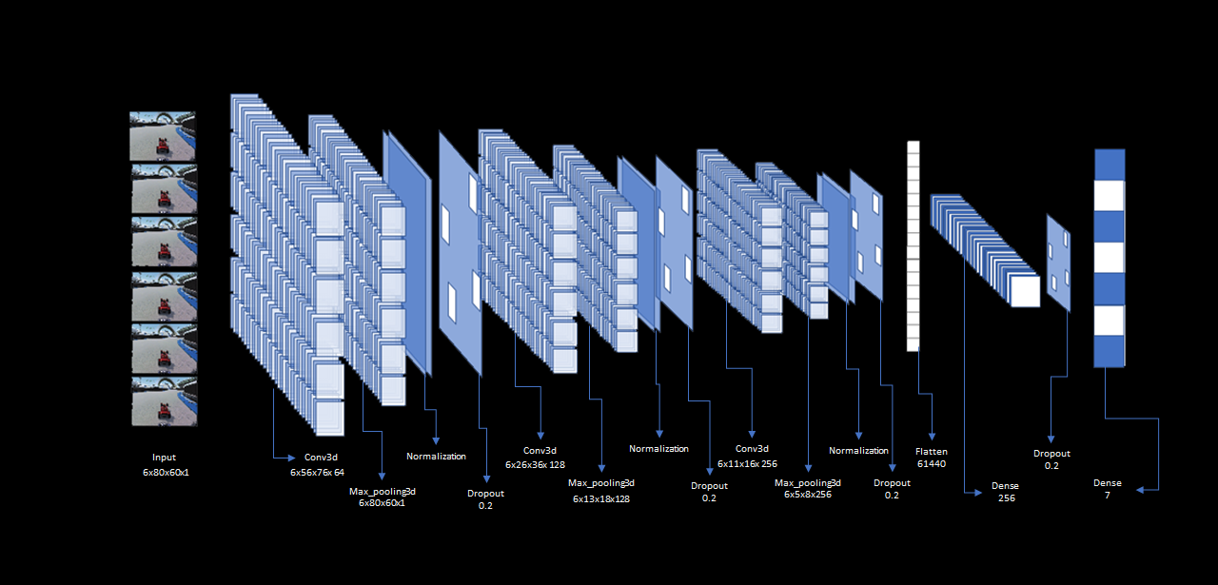
Model Architecture

Slide 8
DEMO: Straight Track

Slide 9
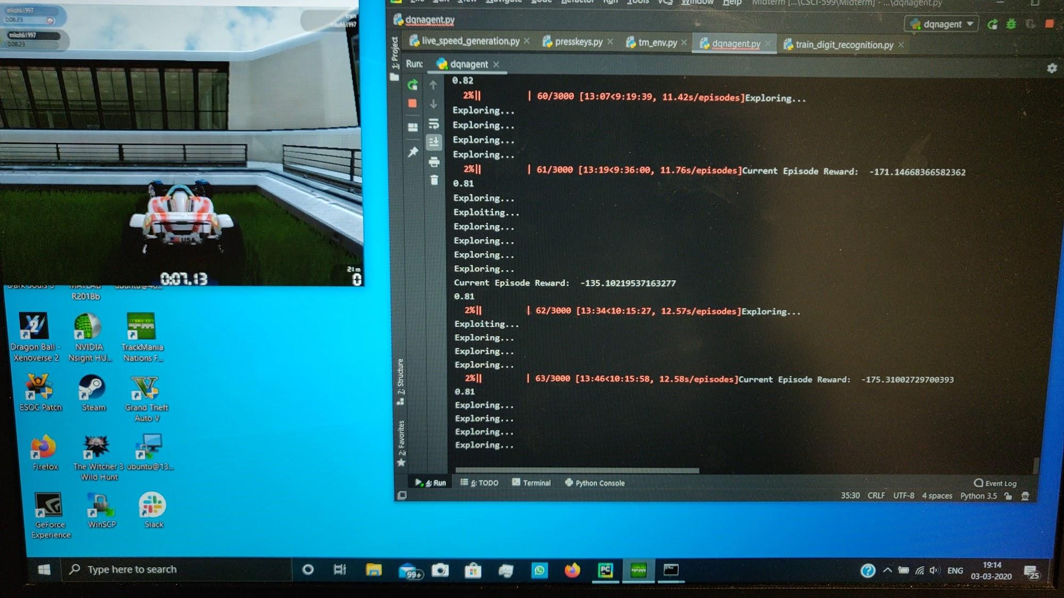

Slide 10
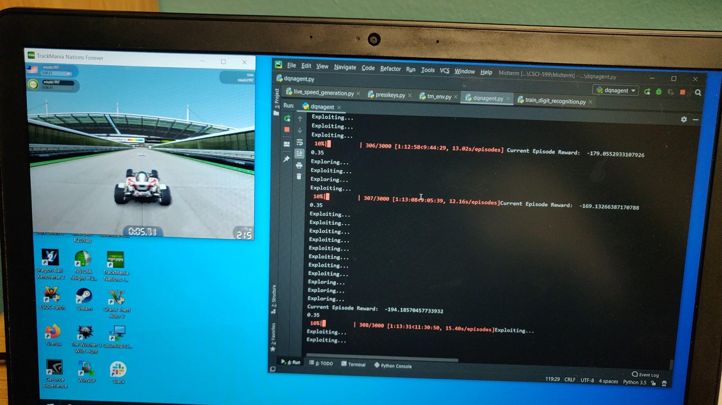

Slide 11
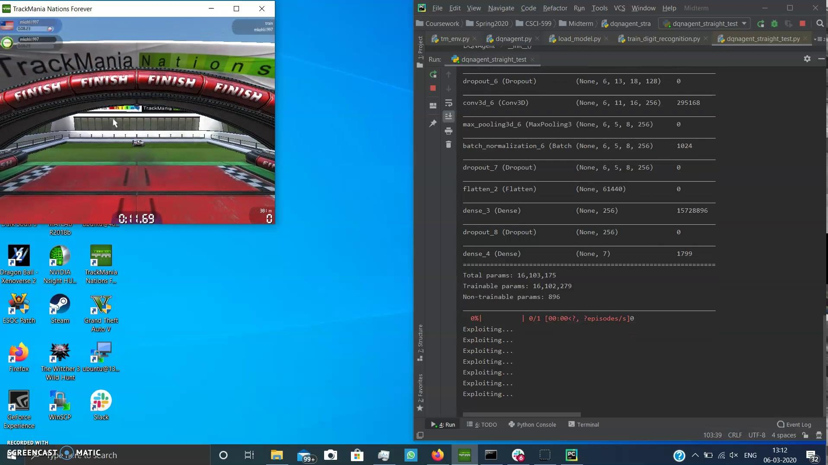

Slide 12
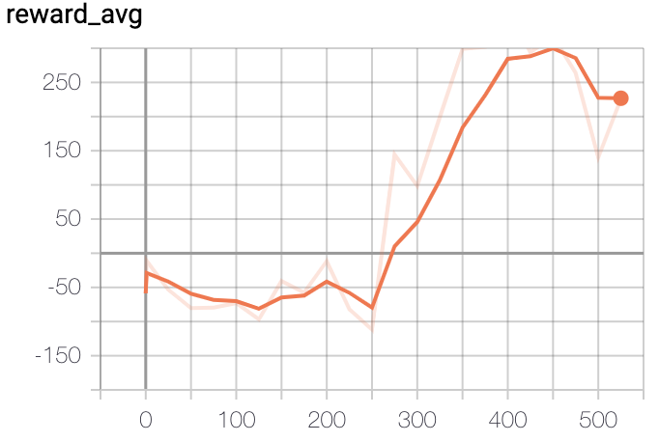
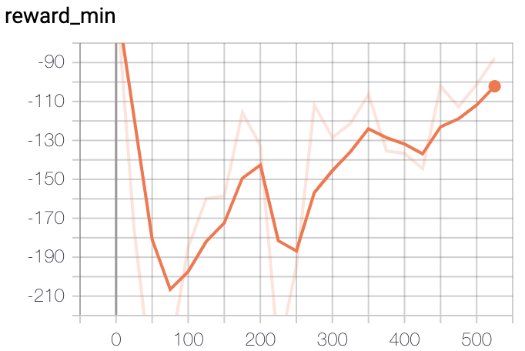
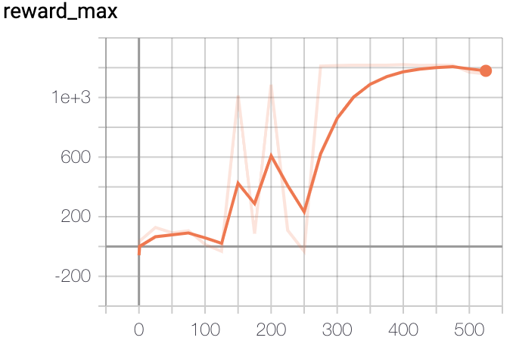
Reward Statsx
The agent was able to complete the straight track race consistently after about 250 episodes, as can be seen from the consistent sharp rise in all the three graphs.

Slide 13
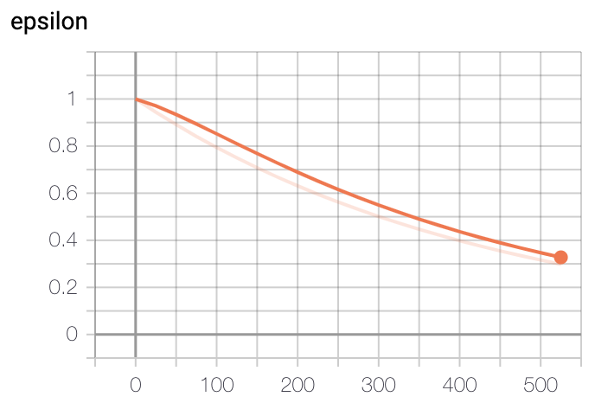
Epsilon and decay rate
The exploration rate(ϵ) was decayed at a rate of 0.9966 per episode.
Once the agent was seen completing the race consistently, the training was stopped at 525th episode.

Slide 14
DEMO: Curve Track

Slide 15
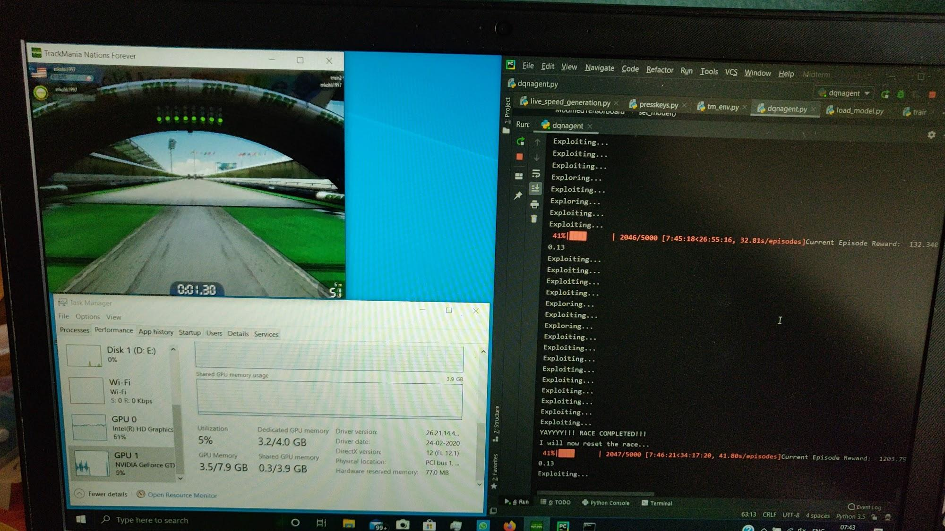

Slide 16
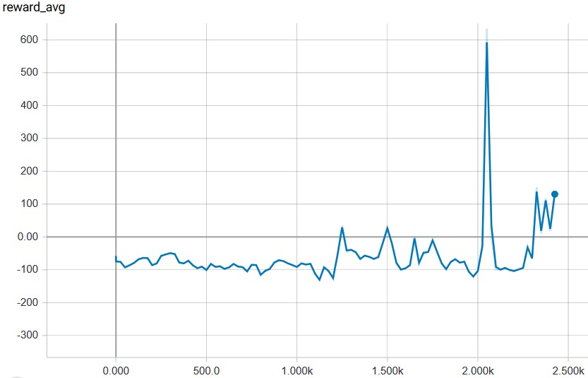
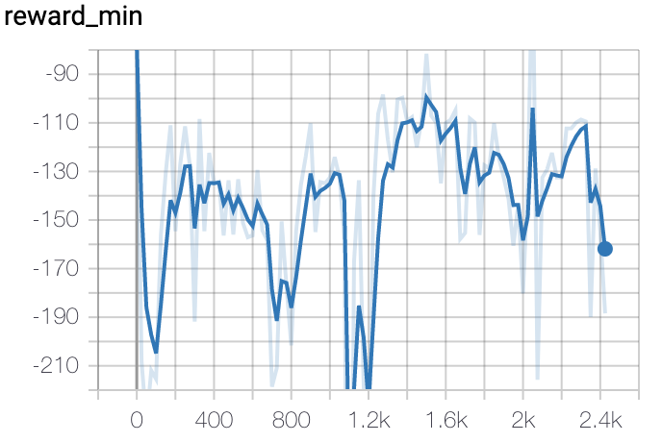
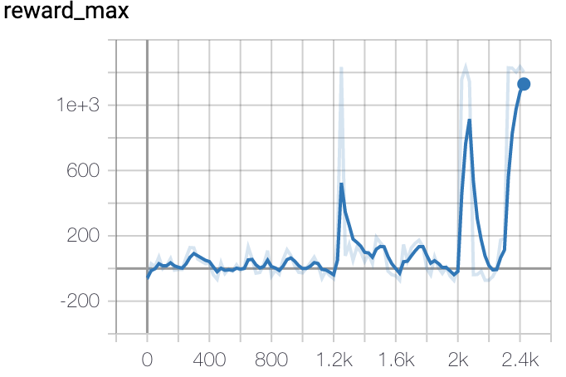
Reward Stats
Our agent completed its first race only after 1200 episodes. But it was only after about 2000 episodes, that it could complete the race consistently with an average of 634 per 25 episodes.

Slide 17
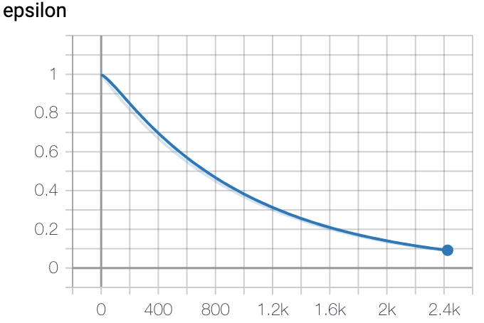
Epsilon and decay rate
The ϵ was decayed at a rate of 0.999 per episode.
When the agent was seen completing the race consistently, the training was stopped at 2500 episodes.

Slide 18
Straight Track vs Curved Track

Slide 19
Problems Encountered and Future Tasks
Insufficient replay memory - solved by increasing the replay memory size to 1000 states
Training in third person increases the number of possible states, so we switched to first person.
Our next task would be to account for collision using a model for collision detection.

Slide 20
THANK YOU

